Slide 1

JAVA PROGRAMMING PROJECT
Student Council Election System
TEAM MEMBERS
FACULTY GUIDE
CAMPUS LOCATION
N. Arjun Kireeti — 2620040117
Balaiah Gudipudi
Bachupally, India
K. Vishwaksena — 2620080044

Slide 2


OVERVIEW
Abstract
Automated campus election platform executing voter verification, real-time ballot tallying, and permanent file archival using core Java foundations.
Voter Check
Digital Ballot
Live Stream
File Archive
Academic year eligibility validation.
Direct candidate vote routing.
Instant collection result mapping.
Permanent text report generation.

Slide 3
CONTEXT
Understanding Problem Statement
Manual Paper Elections
Automated Java System
Slow Verification: Manual student ID checks delay polling queues.
Instant Validation: Relational operators verify academic year immediately.
Counting Errors: Physical paper ballots risk human miscounts.
Exact Tallies: Switch control flow increments encapsulated counters.
Delayed Results: Hours spent sorting physical ballot boxes.
Real-Time Output: Java Streams print live candidate standings.
Fragile Records: Paper tally sheets lack digital backup.
Permanent Storage: FileWriter exports verified counts to disk.

Slide 4
MODULE 1 — COMPUTATIONAL THINKING & JAVA FOUNDATIONS
CO 1 Topics
Basics & Console I/O
// MODULE 1: Basics & I/O
static boolean mod1(Scanner s, int voterNum)
{
System.out.print("\nVoter " + voterNum + " - Enter ID & Year (1-4): "); s.next(); return s.nextInt() <= 4;
}
Typed Input: Reads student ID token and academic year via Scanner.
Relational Check: Evaluates expression <= 4 for voter eligibility.
Boolean Return: Passes verification status directly to main loop.

Slide 5
MODULE 2 — SELECTION & ITERATION CONTROL FLOW
CO 2 TOPICS
Case 1 Branch
Case 2 Branch
Default Fallback
Increments Candidate SRB vote count.
Increments Candidate CNI vote count.
Rejects invalid numeric selections.
// MODULE 2: Control Flow (Switch)
static void mod2(Scanner s, Candidate a, Candidate b)
{
System.out.print("Vote 1 for " + a.name + "Vote 2 for " + b.name + ":\n "); switch(s.nextInt()) {
case 1: a.votes++; break; case 2: b.votes++; break; default: System.out.println("Invalid.");
}
}

Slide 6
MODULE 3 — DECOMPOSITION WITH METHODS & ARRAYS
CO 3 Topics
1D Array
// MODULE 3: Arrays & Methods
static int mod3(int[] arr) {
int sum = 0; for (int v : arr) sum += v; return sum; }
Modular Vote Summation
Passes candidate vote totals inside a 1D integer array to mod3(), traversing elements with an enhanced for-each loop.

Slide 7
MODULE 4 — OBJECT-ORIENTED MODELLING & DESIGN
CO 4
Class Blueprint
Parameterized Constructor
Instance Isolation
Encapsulates candidate state variables.
Initializes distinct candidate instances.
Tracks SRB and CNI counters independently.
// MODULE 4: OOP
class Candidate { String name; int votes = 0; Candidate(String n) { name = n; } }

Slide 8
MODULE 5 — STRINGS & FILE I/O
CO 5
Persistent Election Report
// MODULE 5: File I/O
static void mod5(int total) throws Exception
{
FileWriter f = new FileWriter("Report.txt"); f.write("Total Votes Cast: " + total); f.close(); }
File Stream: Instantiates FileWriter targeting Report.txt.
String Concatenation: Formats total votes cast into output text.
Exception Clauses: Propagates checked I/O exceptions via throws Exception.

Slide 9
MODULE 6 — FUNCTIONAL PROGRAMMING WITH COLLECTIONS & STREAMS
CO 6
API Component | Syntax Used | Functional Role
Map Collection | Map.of(a.name, a.votes, ...) | Stores candidate key-value pairs
Stream Pipeline | .entrySet().stream() | Converts map entries into data stream
Lambda Consumer | .forEach(e -> System.out.println(...)) | Prints formatted candidate results
// MODULE 6: Collections & Streams
static void mod6(Candidate a, Candidate b) {
System.out.println("\n--- Final Results ---"); Map.of(a.name, a.votes, b.name, b.votes).entrySet().stream() .forEach(e -> System.out.println(e.getKey() + ": " + e.getValue())); }

Slide 10
SUMMARY
Conclusion
Combining foundational control flow with Object-Oriented Design, Streams, and File I/O delivers a complete, error-resistant campus voting application.
6
100%
Report.txt
Core Java Syllabus Modules Integrated
Automated Vote Tally Accuracy
Permanent Digital Audit Output

Slide 11
PROGRAM EXECUTION
Screen Shots
How many voters are participating?:2
Enter ID & Year (1-4): 2620040117 1
Vote 1 for SRB
Vote 2 for CNI
Voted=1
Voter 2
Enter ID & Year (1-4): 2620080044 4
Vote 1 for SRB
Vote 2 for CNI
Voted=1
--- Final Results ---
CNI: 2
SRB: 0

Slide 12
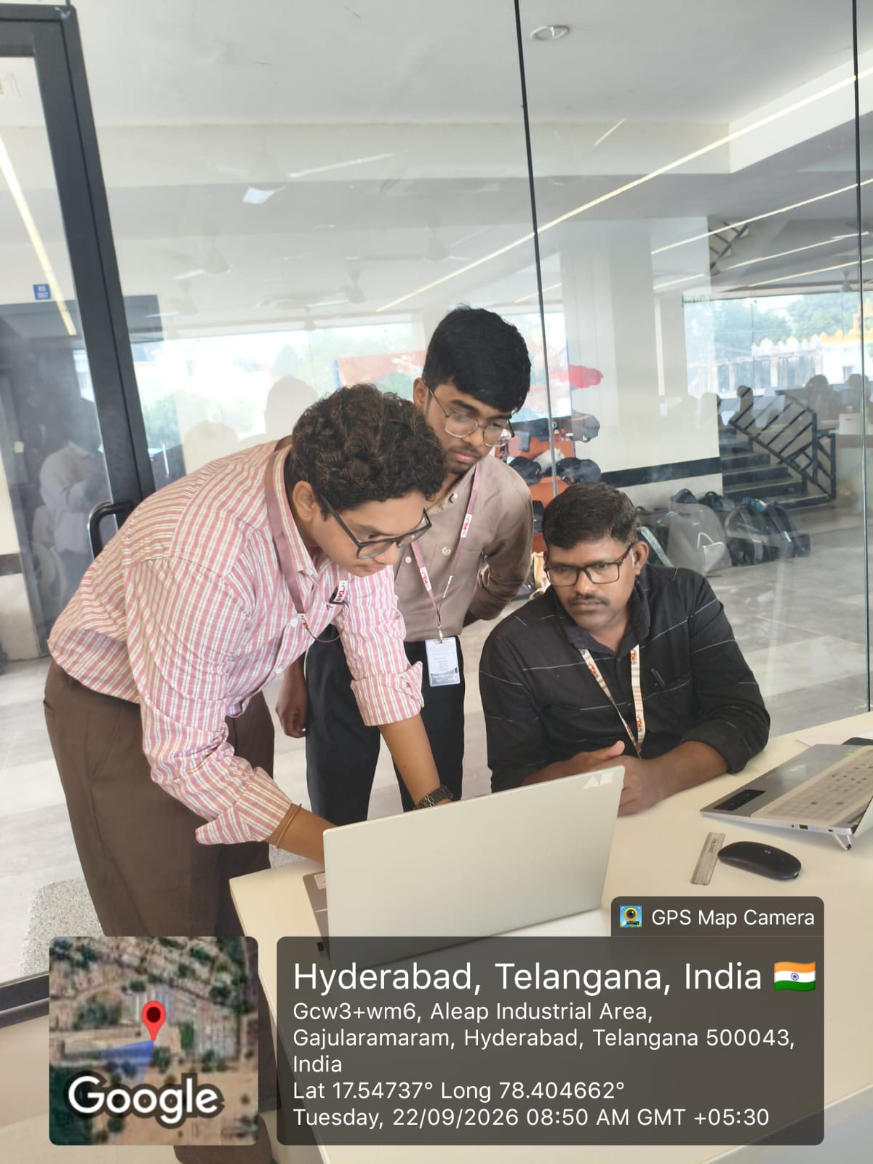
Geo Tag Photo and git hub link
https://github.com/Arjun-Kireeti/JAVA-Student-Council-Election-Project

